Slide 1

NETFLIX USERBASE CASE STUDY
A research project by Yash
Dive into the powerful insights uncovered through a comprehensive analysis of Netflix's user base. Uncover the trends, behaviors, and key metrics that drive the success of the leading global streaming platform.

Slide 2



A Brief Introduction to Netflix
Netflix is the world's leading streaming entertainment service, with over 200 million paid subscriptions in over 190 countries. Founded in 1997, Netflix has revolutionized the way people consume media, offering a vast library of movies, TV shows, and original content at the touch of a button.
Renowned for its personalized recommendations, seamless user experience, and commitment to innovation, Netflix continues to set the standard for the streaming industry. As a pioneer in the on-demand entertainment landscape, the company has transformed the way viewers discover and enjoy content, forever changing the way we think about television and entertainment.

Slide 3
Country with Highest Revenue
$3.3B
74M
Annual Revenue
Subscriber Base
The country with the highest annual revenue for Netflix is the United Kingdom, generating over $3.3 billion in 2022.
The US subscriber base for Netflix stands at a staggering 74 million, more than any other country in the world.

Slide 4
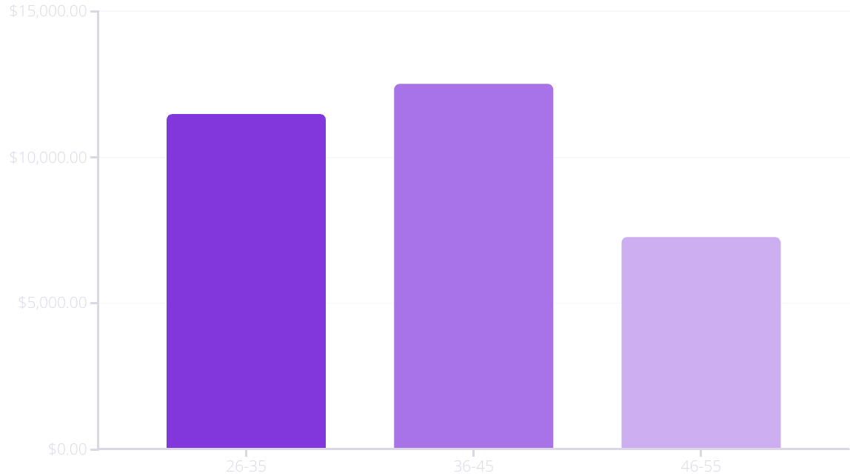
Monthly Revenue by Customer Age Group
The monthly revenue generated by Netflix varies significantly across different age groups. Customers in the 35-44 age range are the most valuable, contributing the highest monthly revenue on average.

Slide 5

Lifetime Value (LTV) by Subscription Type
Basic
Standard
Premium
The lifetime value (LTV) of Netflix customers varies significantly based on their subscription type. Premium subscribers, who pay the highest monthly fee, have a LTV of $3872. This highlights the importance of encouraging upgrades to higher-tier plans.

Slide 6

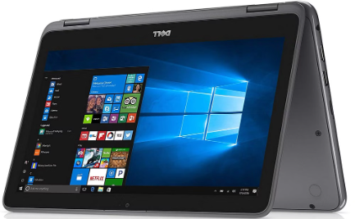

Most Popular Customer Devices
Smartphones
Laptops
Tablets
Smart TVs have become increasingly popular for Netflix viewing, allowing customers to enjoy the big-screen experience from the comfort of their living rooms. Smart TVs make up about 30% of all Netflix usage.
Laptops are the most widely used device for accessing Netflix, accounting for over 60% of all streaming activity. Customers appreciate the convenience and portability of watching content on-the-go.
Tablets are another common device for Netflix, accounting for around 10% of streaming activity. Their larger screens and portability make them a convenient choice for customers who want a more immersive viewing experience.

Slide 7
Conclusion and Key Takeaways
Diverse Revenue Streams
Importance of Retention
Netflix's subscriber base and revenue generation span across various demographics, highlighting the platform's broad appeal and ability to monetize customers through different subscription tiers.
Longer subscription durations and higher lifetime values for premium customers emphasize the significance of customer retention strategies to drive sustainable growth.
Device-Agnostic Approach
Continued Innovatio
Netflix's ubiquity across smartphones, smart TVs, and tablets underscores the need for a seamless, device-agnostic user experience to cater to evolving customer preferences.
Ongoing investments in content, technology, and customer-centric initiatives will be crucial for Netflix to maintain its leadership position in the highly competitive streaming industry.

